Slide 1

Priority setting in health
- Process, fairness and legitimacy
Kjell Arne Johansson, MD, PhD
Professor, specialist in addiction medicine

Slide 2
How can we include the interests of all people into decision making?

Slide 3
Why fair process?
Include the views of those who will be affected
Provide legitimacy and trust
Value trade-offs should be informed by public views
Educationally valuable for the citizens
Norman Daniels and James Sabin, Setting Limits Fairly, 2002

Slide 4
Disagreements
Evidence, indicators and analytics
Principles and criteria
Relative weight of criteria

Slide 5
Accountability for reasonableness (A4R)
- fair and legitiamte process
  Publicity
  Relevance
  Revision and appeals
  Enforcement/institutionalisation
(Daniels N. and Sabin J. Setting limits fairly, OUP 2002/08)

Slide 6
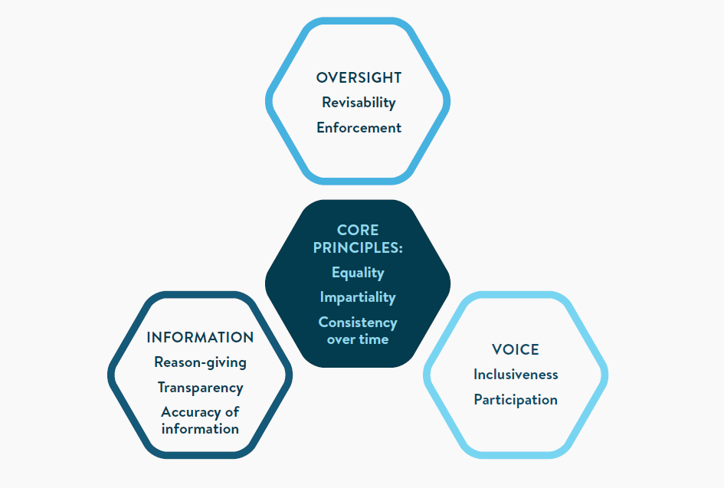


Slide 7
10-step strategy process for fair essential health care package priority setting process
Three principles that apply for all steps:
    Involvement of relevant key stakeholders
    Transparency about decisions and their rationale, and the development process
    Deliberation - thoughtful examination of different perspectives, arguments, and information to arrive at a well-informed decision
Planning
Criteria - interventions
Financing
Analyses - priorities
Implementation - monitor
Step 1: Develop roadmap
Step 3: Identify criteria for selecting intervention to EHCP
Step 5: Conduct fiscal space analysis and decide budget space and period
Step 7: Collect evidence and conduct analyses needed to prioritize interventions from step 4 in accordance with criteria in step 3
Step 9: Decide how the EHCP will be implemented.
Step 2: Establish management and working groups
Step 8: Set priority of each intervention
(“high”, “medium”,“low”)
Adjust target coverage to feasible level
Step 10:
Plan monitoring and evaluation, and structure future revisions
Step 4: Identify interventions that are candidates for the EHCP
Step 6: Decide how the EHCP will be financed
Source: Mwalim O et al, work in progress (2024)

Slide 8


Kjell Arne Johansson
Professor
kjell.johansson@uib.no

