Slide 1

Priority setting in health
- Principles and criteria
Kjell Arne Johansson, MD, PhD
Professor, specialist in addiction medicine

Slide 2
Ethical principles for priority setting
Maximize health
Priority to worst-off
Financial risk protection

Slide 3
How to maximize health impact?
% Given
Cost-effectiveness

Slide 4
How to maximize health impact?
  Give more to health
% Given
Total Impact
Cost-effectiveness

Slide 5
How to maximize health impact?
  Give more to health
  Invest in cost-effective interventions
% Given
Total Impact
Cost-effectiveness

Slide 6




Disease control priorities

Slide 8
Who are worst-off in terms of health?
Those having conditions with the lowest lifetime health?
The poorest or other disadvantaged groups?

Slide 9
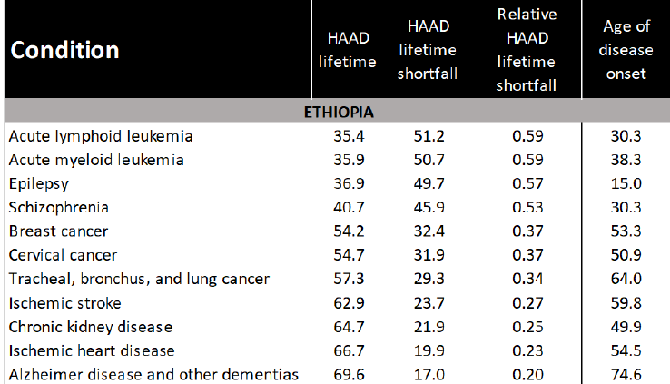
Lifetime health loss
– a measure to identify worst-off
Healthy life years lost
- lifetime
Source: Johansson et al., Health by disease categories

Slide 10
Reduce out-of-pocket payments
Barrier to access
Financial burden
…and move towards public finance
(mandatory prepayment with pooling of funds - tax/insurance)

Slide 11
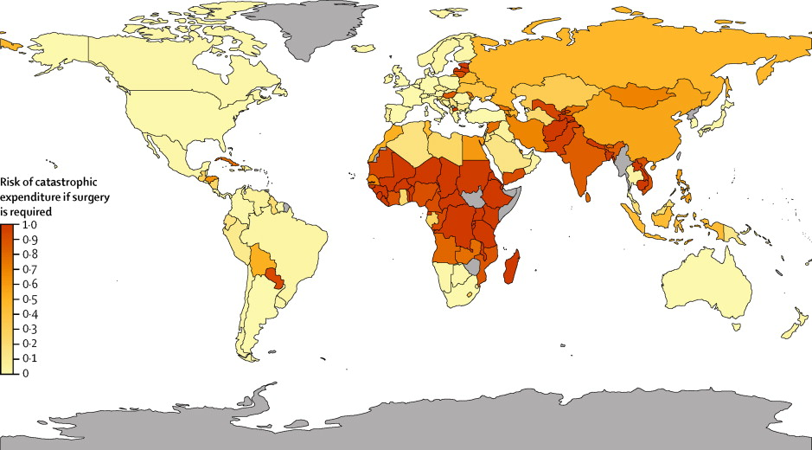
Source: Shrime et al., The Lancet Global Health (2015)

Slide 12
Ethical criteria for selecting services
Acceptable criteria
Contested criteria
Unacceptable criteria
Maximize health
  Cost-effectiveness
  Effectiveness
  Quality of evidence
Priority to worst-off
  Lifetime health loss
  Disadvantaged groups
Financial risk protection
Gender
Sexual orientation
Religion
Race
Social status
Education
Age
Productivity
Responsibility for health
Disease burden
Budget impact
Rare diseases
Source: WHO Guidance on priority setting in health care (GPS Health) 2014, Prioriteringsforskriften (2017), WHO Fair Choices on Pathway towards UHC (2016), Norheim OF. Health Care Analysis 2002

Slide 13


Kjell Arne Johansson
Professor
kjell.johansson@uib.no

